Slide 1
Crown, not Cap
DR GURBAKSH SINGH

Slide 2

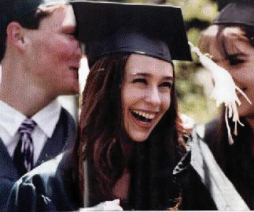
By the grace of God, I completed my studies in Ph.D. (Agronomy) at Ohio State University, Columbus, Ohio in August 1963.
It is an old episode but it is very fresh in my mind because of the emotional dialogue, I had with a press reporter.
The auditorium was full with more than 7,000 graduates wearing black gowns and black caps, standing to receive their degrees.
My white turban in that black background was conspicuous and caught the eye of a press reporter.

Slide 3

Through the rows, he came straight to me and asked, “Why are you not wearing your academic cap?
Are you not proud to have earned it? I know you must have worked hard for this honour.”
. I responded smilingly, “The crown, you see on my head, took 200 years to be earned and sacrifices had to be made to retain it; the degree took only 2 years

Slide 4
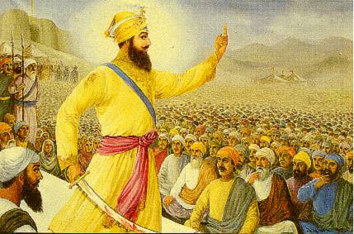
Graduation Ceremony of the Sikhs in 1699
Why should I exchange this invaluable crown for any cap?”
This helped us to have informal talks during which I explained the founding of the faith in 1499 by Nanak
(Do not divide humanity into different faiths, all humans are brothers and sisters being the children of the same Father-Mother (God);
work for welfare of the whole humanity)
graduation ceremony of the trainees (disciples, Sikhs) was held in 1699 when this crown was bestowed on us and we were knighted as Saint-soldiers (Legions of the Lord for peace, the Guru Khalsa Panth).

Slide 5
Sikh, wearing a crown earned in 200 years, looks at a cap earned in 2 years.”
Next morning,, the airhostess comes to me and tells, “A lady has an urgent message for you.
Would you, please, come to the window?”
The lady of a local catholic family, who invited me to spend my weekends with them and their friends, handed me the newspaper with my front-page picture, wearing a turban and looking towards the cap in my hands;
the heading: “the Sikh, wearing a crown earned in 200 years, looks at a cap earned in 2 years.”

Slide 6

our gift
In the very short time, allowed to her to talk to me, she said with her face glowing with pleasure, “I showed this picture to the airport manager, he was happy to see it, and allowed me in.
This is our gift to you, a life long memory of our love for you. Carry it to your family.”
Tears rolling in our eyes, we saw between us the window being shut.

Slide 7
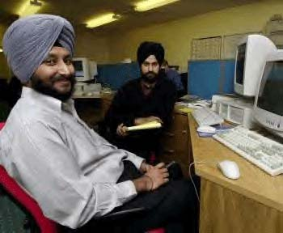
“Turban is a crown granted to a Sikh to make him Sardar Ji, we should feel obliged to the Guru every morning when we wear it.”

